Slide 1
Energy in cells
Year 11 Biology
Bremer SHS

Slide 2
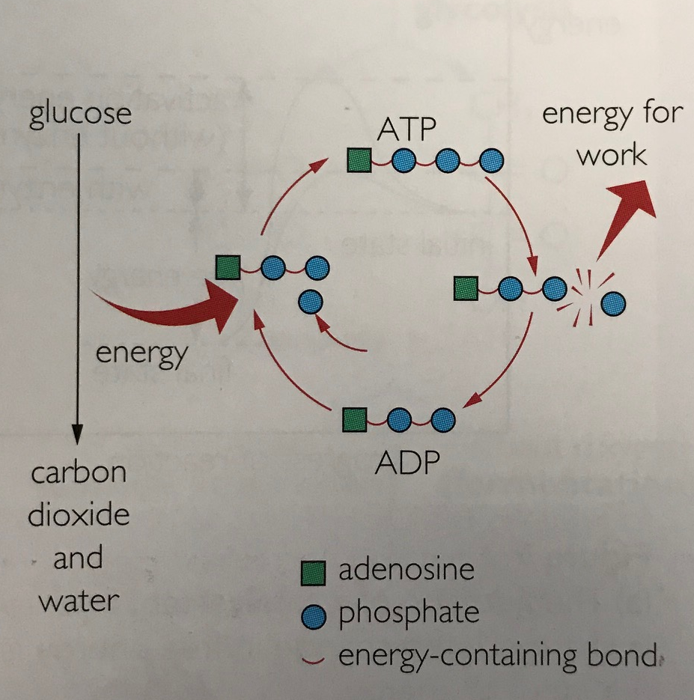
energy
All organisms require energy to grow, reproduce, move and carry out fundamental maintenance and repairs.
Living organisms use the chemical energy carried in phosphate bonds of ATP.

Slide 3
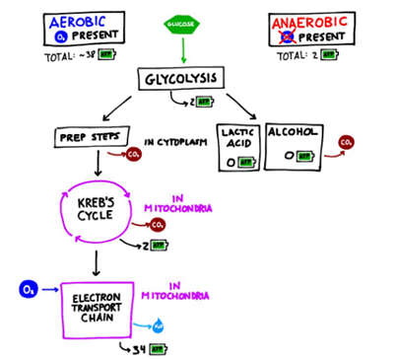
Cellular Respiration
Organisms obtain the energy to make ATP from glucose molecules through cellular respiration, a series of chemical reactions controlled by enzymes.
Aerobic respiration (glycolysis, Krebs cycle and electron transport) occurs in the presence of oxygen.
Anaerobic respiration occurs in the absence of oxygen.

Slide 4
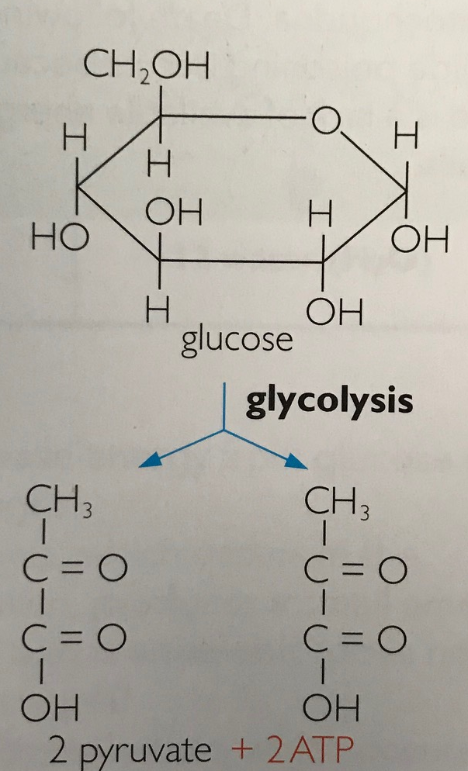
glycolysis
Initial stage of the breakdown of glucose.
Can occur with or without the presence of oxygen.
Occurs in the cytoplasm.
Common for both aerobic an anaerobic respiration.
One glucose molecule is converted to 2 pyruvate molecules and produces 2-4 ATP.
2 hydrogen acceptor (NADH) molecules also produced.

Slide 5
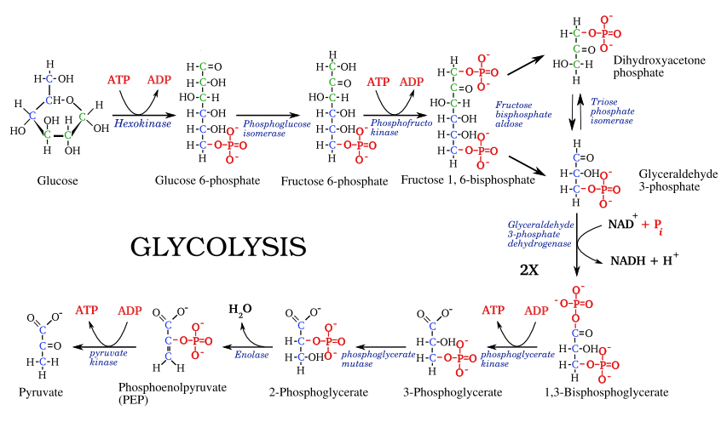
But in reality….
Things are a little more complex.

Slide 6
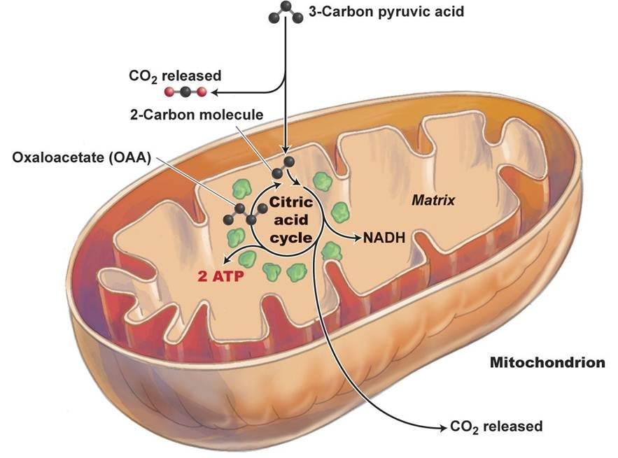
Krebs cycle (citric acid cycle)
Occurs after glycolysis if oxygen is available.
Takes place in the mitochondrial matrix.
2 ATP (1 from each pyruvate molecule), carbon dioxide and hydrogen is produced.
Hydrogen atoms collected by hydrogen acceptor molecules (10 NADH + 4FADH₂)

Slide 7
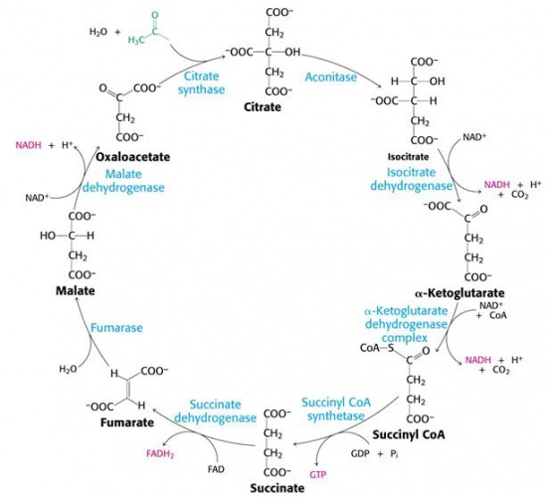
Things are still very complex…

Slide 8
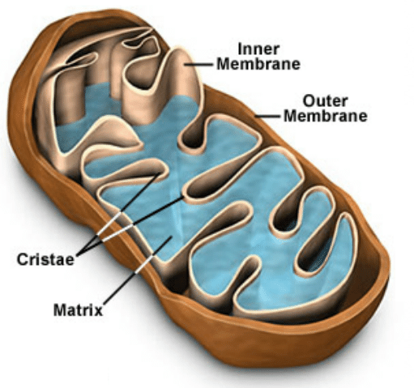
ELECTRON TRANSPORT chain
Hydrogen acceptor molecules (NADH + FADH₂) give up hydrogen atoms to combine with oxygen and orm water.
Process releases enough energy to form 32 ATP molecules.
Takes place in the mitochondrial cristae.

Slide 9
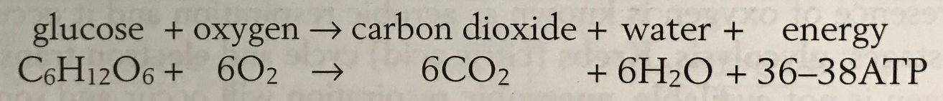
summary
When oxygen is present, the energy released from one glucose molecule is 36-38 molecules of ATP.

Slide 10
Check for understanding
Construct a diagram to show how one molecule of glucose can be used to produce 36-38 molecules of ATP in the presence of oxygen.

Slide 11
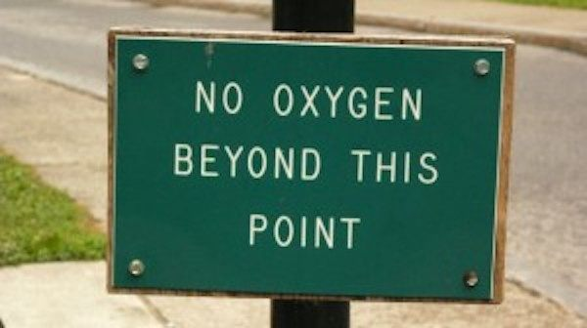
Anaerobic respiration
All organisms can metabolize glucose anaerobically (without oxygen) using glycolysis in the cytoplasm.
Fermentation pathways for glucose metabolism do not use oxygen as a final electron acceptor. An electron acceptor must occur or glycolysis will stop.
The energy yield from fermentation is low, and few organisms can obtain sufficient energy for their needs this way.

Slide 12
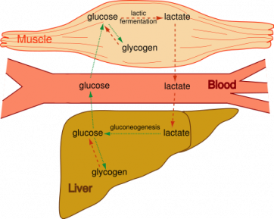
Anaerobic respiration
During lactic acid fermentation the electron acceptor is pyruvate itself and the end product is lactic acid.
Lactic acid build up is toxic and must be broken down via enzymatic action.

Slide 13
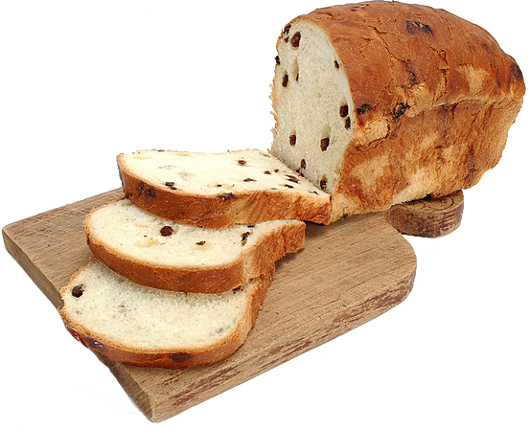
fermentation
Fermentation is completed after glycolysis by organisms such as yeasts and bacteria.
In alcoholic fermentation the electron acceptor is ethanal, which is in turn converted to ethanol.
There is no additional ATP formed after glycolysis, it prevents accumulation of pyruvate and allows glycolysis to continue.
Toxic when ethanol levels are too high.
Bread (above) rises during baking as a result of the carbon dioxide given off during alcoholic fermentation.
Alcoholic beverages such as beer, derive their alcohol content from the ethanol produced from alcoholic fermentation.

Slide 14
Check for understanding
Describe the key difference between aerobic and anaerobic respiration.
Why is the efficiency of anaerobic pathways so low?
Why can’t alcoholic fermentation go on indefinitely?

